Slide 1
Employability of African engineering students
Duncan Onyango Mbuge

Slide 2


UNIVERSITY OF NAIROBI
Faculty of Engineering
DEPARTMENT OF ENVIRONMENTAL AND BIOSYSTEMS ENGINEERING

Slide 3
Engineering Education

Slide 4
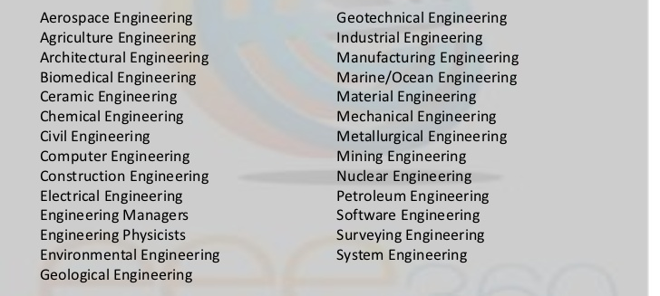
TYPES OF ENGINEERING COURSES

Slide 5
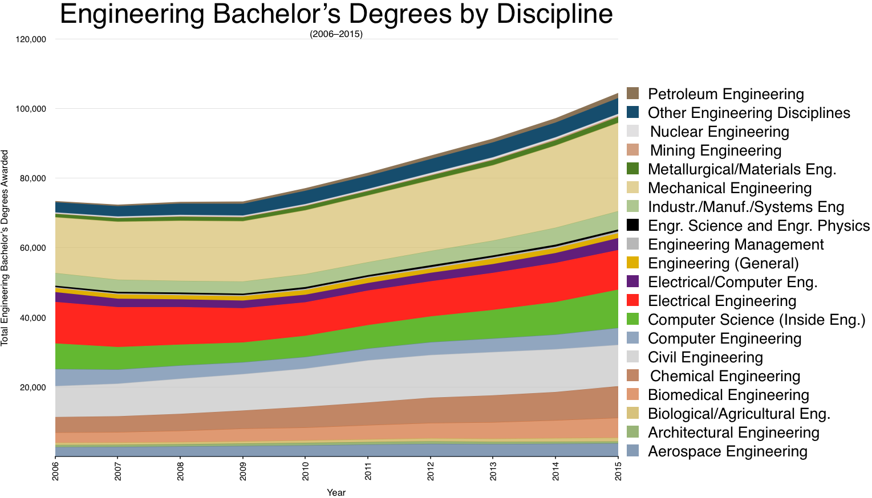

Slide 6
OUTLINE OF ENGINEERING CURRICULUM
Year 1
Basic Sciences (Mathematics, Physics, Chemistry)
General Courses (Philosophy, Economics, Communication skills, HIV/Aids)
Year 2
Basic Engineering Courses + Mathematics
Fourth Term (Practicals)

Slide 7
OUTLINE OF ENGINEERING CURRICULUM
Year 3
Basic Engineering Courses + Mathematics
Fourth term (Practicals)
Year 4
Specialized Design Courses
Industrial Attachment
Year 5
Specialized Design Courses
Management courses

Slide 8

(Iowa State University, College of Engineering)

Slide 9
TYPES OF QUALIFICATIONS IN ENGINEERING
Bachelor of Science (B.Sc.) – Theory + Practical + Research + Management
Bachelor of Technology (B. Tech.) – Theory + More practical
Bachelor of Engineering (B. Eng.) - Theory + More management
Bachelor of Philosophy (B. Phil.) - Theory + Research
M.Sc., M.Eng., M.Phil
Ph.D., D.Sc.

Slide 10
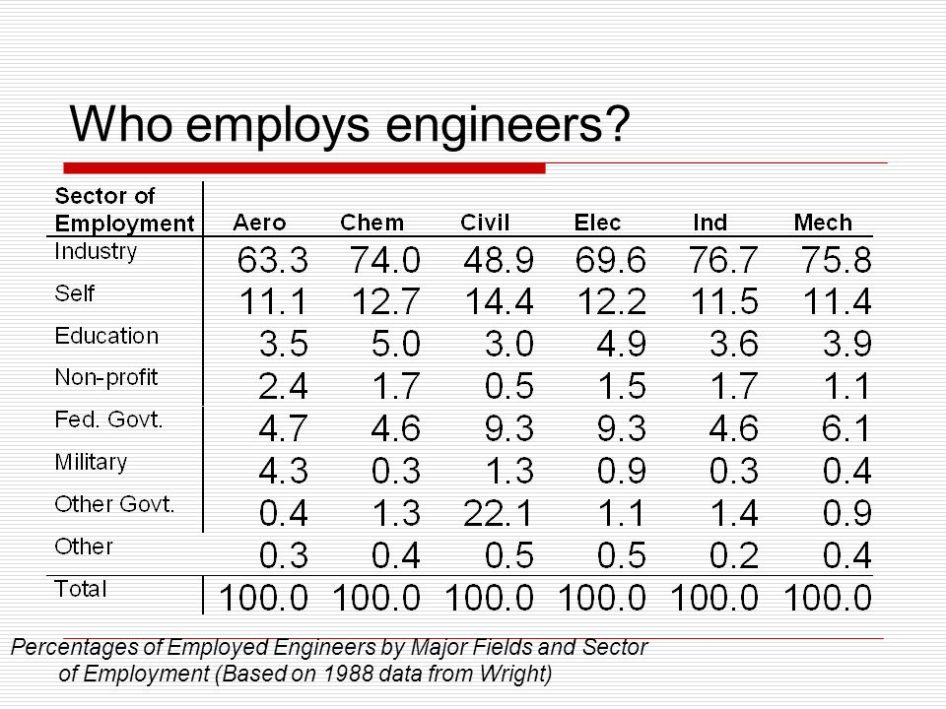

Slide 13
Factors that affect employability of engineering graduates
1. International and national Economic factors
2. National policies
3. Individual traits
4. Internships

Slide 14
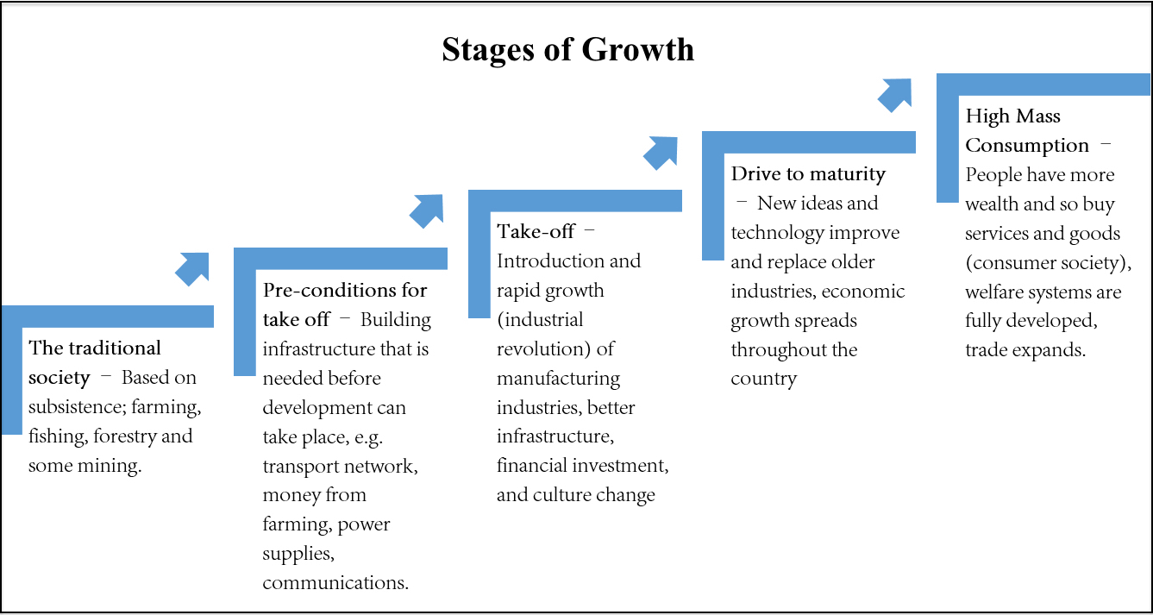
1. International and National Economic factors

Slide 15


Slide 16


Slide 17
2. National policies
Establishment of County Governments
New parastatals
International contractors
Engineering firms headed by other professionals

Slide 18
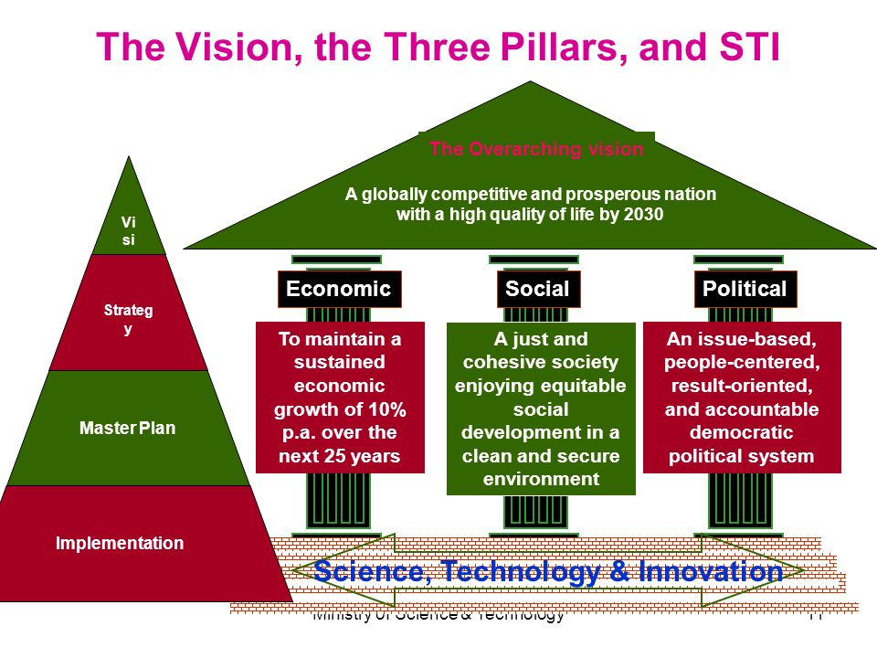
KENYA VISION 2030

Slide 19

BIG 4 AGENDA

Slide 20
Internships and Industrial Attachment

Slide 21

INDIVIDUAL TRAITS
Grooming
Temperament
Team player
Confident

Slide 22
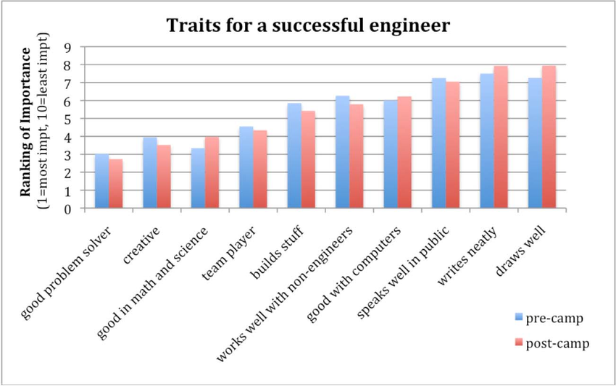
Chen et al (2010)

