Slide 1
STUDENT INDUSTRIAL SECONDMENTS IN EAST AFRICA:
Project reporting
G. Sheikheldin, M. Mutambala, B. Diyamett and B. Nyichomba.
Project conclusion workshop, 1-2 December 2021.

Slide 2
Outline
introduction
study design
findings
challenges
discussion: engineering ecosystems
general conclusions
future possibilities
recommendations

Slide 3
introduction
Engineering fields play a crucial role in developing solutions to the world’s technical issues; they bring ideas into reality and particularly contribute to strengthening the capacity of the industrial sectors (SDG 9) which is critical for sustained economic growth (SDG 8) and other SDGs.
Historically, engineering education in East Africa (EA) began later than many other disciplines, such as the social sciences. The formation of the East African Community (EAC) in 1967 helped unify the education system across the countries in the region. Engineering students from Tanzania and Uganda used to study at the University of Nairobi, Kenya.
Structural adjustment programs, in the 1980s, affected the education sector in African countries in visible ways. Full state funding was abandoned; expansion in schooling staggered and then reversed in the economic decline of the 1990s.

Slide 4
introduction (cont.)
Problem:
A global report by UNESCO, published 2010, emphasized that Africa was struggling with a serious shortage of engineering practitioners (EPs – engineers, technologists, technicians) compared to the needs of development. Later on, surveys from academia and industry indicated that both numbers and competencies of local practitioners in Africa require improvement.
Some studies suggest that in bridging theory and practice, co-curricular activities such as industrial training/attachment, internships with industries after graduation, etc., need to be integrated.
EA engineering and technology schools are not unfamiliar with SIS models and experiences, but general challenges and limitations appear to be dominant in the current SIS programs.

Slide 5
study design
A study of best practices, to produce evidence-based and evidence-informed policy recommendations, in establishing and running robust engineering SIS programs coordinated between universities and industries – and perhaps with support from the public sector – to serve both the industries and students. (funded by IDRC Canada).
Qualitative approach - historical case study strategy - employing primary and secondary data through survey and literature review to synthesize effective experiences of SIS programs in EA and globally:
Phase I: surveying – mapping SIS experiences, surveying best practices, and selecting pilot partners.
Phase II: piloting – assigning engineering students, (1 year to graduation) SIS placements. University Paterners.
Phase III: synthesis and result dissemination.

Slide 6
study design
Main objectives:
to gain reliable knowledge and understanding of the potential of tertiary SIS programs in strengthening engineering ecosystems in East Africa;
to examine selected best practices in SIS pedagogical approaches, through initiating, monitoring and evaluating SIS placements;
to map existing and past experiences of SIS programs within tertiary education institutions in East Africa; and
to share the findings of this projects with concerned circles of training and policy responsible for STI enhancement in East Africa and sub-Saharan African overall.

Slide 7
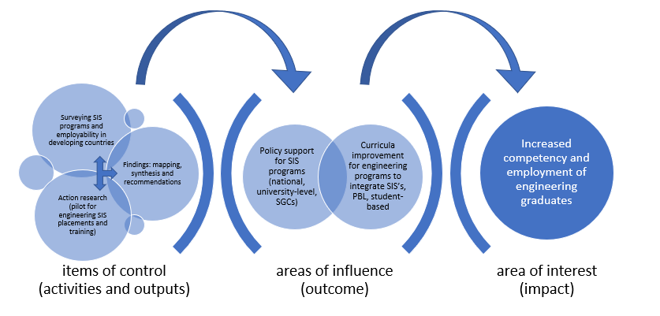
study design (theory of change)

Slide 8
findings: survey
Most major East African universities (colleges of engineering) have had SIS programs for decades. They are also quite similar to each other nowadays: 4-8 weeks, each year (except senior year) in familiar industries. Industries are often mandated by government to participate.
Main challenges with existing SIS programs:
Number of industries is limited, and the number of engineering students is relatively larger, plus they are all required to do their SIS at the same time period. This results in congestion and the inability to give individual students sufficient tasks and attention.
SIS periods are not enough to ground students in work. This complaint is reported equally by students, faculty and industries.
There are no clear formats, frameworks and records, to monitor and measure outcomes from the existing SIS programs.

Slide 9
findings: pilot
Junior undergraduate students from University of Dar es Salaam (College of Engineering and Technology) and University of Rwanda (College of Science and Technology). Each university had 2 students participating in the pilot, selected and funded to take a year of SIS with chosen partner industries/firms. Selection of students was finalized by the universities themselves based on agreements with STIPRO – drafted and signed between October and November 2019.
Was originally planned that about half of the students joining the pilot phase should be female. Eventually, 3 female engineering students and one male student.
All SIS pilot placements were completed, and student reports submitted (reviewed/approved by industry + academic supervisors).
Positive reporting. Back to Scheel. One student already offered position.
Notes:
The highlights from the student reports show similarities on two aspects:
Increase of employable skills: All student reports highlight an increase in hands-on skills and understanding of practical/work environments.
Increase of confidence: comparing the level of confidence in their own skills, from the point they began the SIS placement to the point they finalized their placement, the reports show that the students have gained significant confidence in their ability to secure employment after graduation.

Slide 10
challenges
In phase II of the project two main challenges were encountered:
Securing a second partner university for the pilot (SIS placements) and preparing agreements with universities to lead and supervise placements.
Delays in locating industries and finalizing SIS placement requirements (partially for Tanzania placements and mostly for Rwanda placements); and
National and international measures in response to the Covid19 pandemic, the pilot phase did not end within the year planned.
Sought additional funding to increase number of students. No success.

Slide 11
discussion: engineering ecosystems
We took a systems thinking approach to our study, and it has generally proven to be quite useful in understanding the existing context and problematic areas. Engineering ecosystems are broad and interlinked, but considerable observations show a systems’ phenomenon at work:
reinforcing feedback loops (e.g., less competent engineers graduate, less employed, less new students join engineering schools, less pressure to improve engineering curricula);
system delays (changes in curricula, or training of instructors in Problem-Based Learning, can only show outcome in years after implementation); and
possible leverage points (e.g., changes in structure and financing mechanisms of SIS programs).

Slide 12
discussion (cont.)
Several feedback loops, such as:
shortage of local engineers → current graduates don’t find jobs → skills are not enhanced, and industries complain about competence → less students join engineering → shortage of local engineers (reinforcing feedback loop)
industries complain about competence of local engineers → graduates expected to prove competence → requiring employment in order to build competence, but work often goes to expats → graduates unable to build competence → industries complain (balancing/negative feedback loop)
low technology localization in African countries leads to low local capacity to execute big engineering projects → big engineering projects are assigned to foreign industries → more foreign expats oversee engineering operations, while most local engineers given specific tasks → more big engineering projects implemented without technology localization (negative loop).

Slide 13
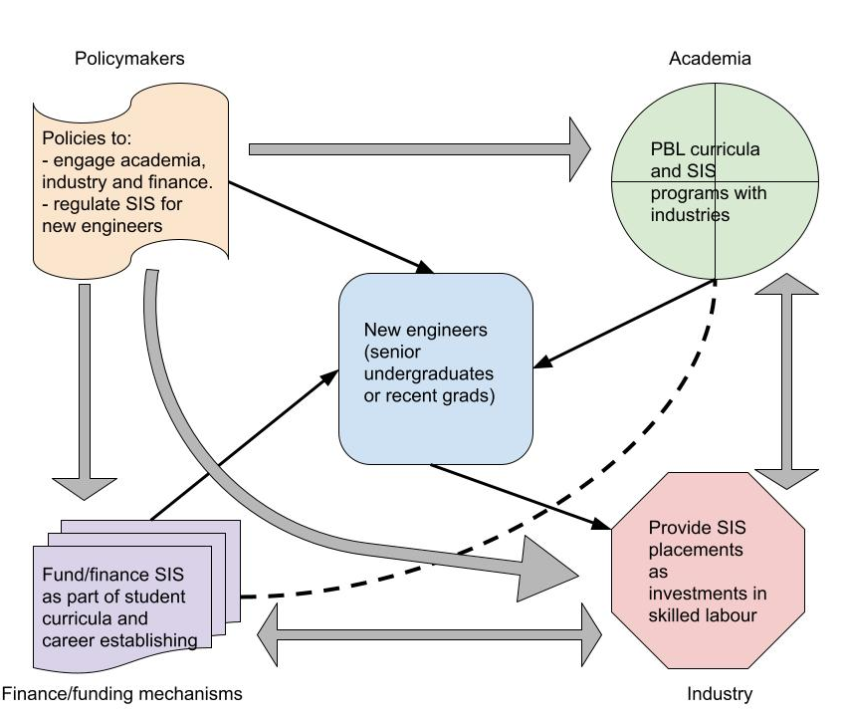
discussion (cont.)
Engineering ecosystem influencers/actors and employability of new engineers
Legend:
↗ from-to inputs
---- inter-influence (various relations)
↔ indirect influence (through policy or relation

Slide 14
general conclusions
The four East African countries of Tanzania, Rwanda, Uganda and Kenya share many similar characteristics and patterns, in history and current challenges and interlinkages, making them a good example of a regional ‘engineering ecosystem’ existing along national ecosystems.
The study’s findings support that long-term SIS placements help increase the employability of engineering students, according to industries, students and academic supervisors. Short-term SIS placements are relatively useful but pose challenges and inefficiencies as the number of students increases while the size of local industries and level of financing remain steady.
A system’s approach points towards a need for recognizing feedback loops and delays in the engineering ecosystems as they respond to a twofold problem: the relative shortage of engineers and limitations to employability.

Slide 15
project outputs
Journal article (peer-reviewed): Sheikheldin, Gussai and Nyichomba, Bavo. 2019. ‘Engineering education, development and growth in Africa.’ Scientific African, Vol. 6. e00200
Participation in AfricaLics special session: On the 4thAfricaLics conference, held in Dar es Salaam, 22-24 October, a special session is organized to be on ‘engineering education, growth and innovation in Africa’.
Conference paper (peer-reviewed, published in conference proceedings): 2020. ‘Student Industrial Secondments in East Africa: Improving Employability in Engineering’ in Disruptive Engineering Education Amidst Global Challenges: WEEF & GEDC Virtual Conference Proceedings, 16-19 November, Danvers: IEEE.
Project Final Technical Report (in-progress).
dissemination workshop report, journal paper(s), policy brief(s).

Slide 16
future possibilities
Further research on scaling is needed to strengthen evidence and understand the ecosystem more but requires buy-in from the triple helix (government-academia-industry) to increase the number of SIS placements, perhaps for a second larger project.
Partnering with regional and/or continental agencies to vocalize the issue and build more interest and ideas.
Funding is a challenge: possible pathways for a second project, and possible pathways for sustainable (continuous) funding/managing.
Regulations and logistics related to engineering students taking longer periods off coursework to pursue SIS placements. Can they be included in curricula (as in some universities) or officially accommodated?

Slide 17
recommendations
Improve communication, collaboration and planning between government, academia and industries to address demand and supply of EPs.
Co-curricular activities have proven worldwide to improve graduates’ preparedness for employment after graduation. HEIs should seek to enhance and invest in co-curricular activities, including SIS programs.
Problem Based Learning (PBL) and Challenge Based Learning (CBL) in engineering curricula can be treated as necessary, not only an option.
Bring engineering to the forefront of the debates and policymaking for the STI Strategy for Africa (STISA) 2024 and for the SDGs.

Slide 18
“The development of a country is brought about by people, not by money. Money, and the wealth it represents, is the result and not the basis of development. The four prerequisites of development are different; they are:
People;
Land;
Good Policies;
Good Leadership.”
-J. K. Nyerere, 1967, ‘The Arusha Declaration’

Slide 19
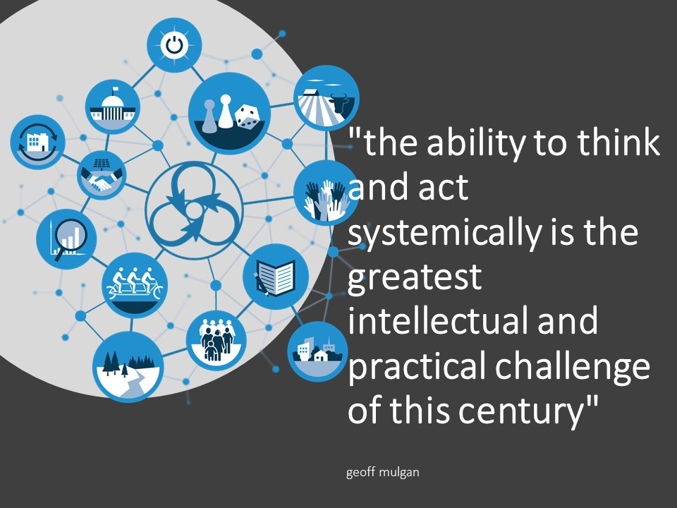

Slide 20
THANK YOU FOR LISTENING

